Slide 1

Gas Station

Slide 2
Problem Definition:
We all face the problem of congestion when we go to fill our car with fuel or diesel.
Therefore, a solution to these problems must be thought, especially if the car wants to go to an emergency trip.

Slide 3


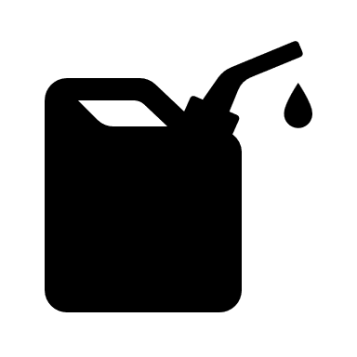
Problems
Long wait time
Overcrowding
fuel shortage

Slide 4
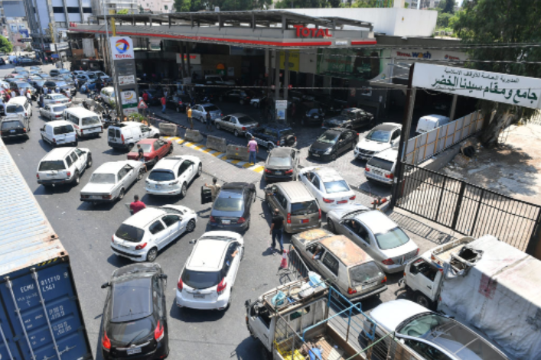
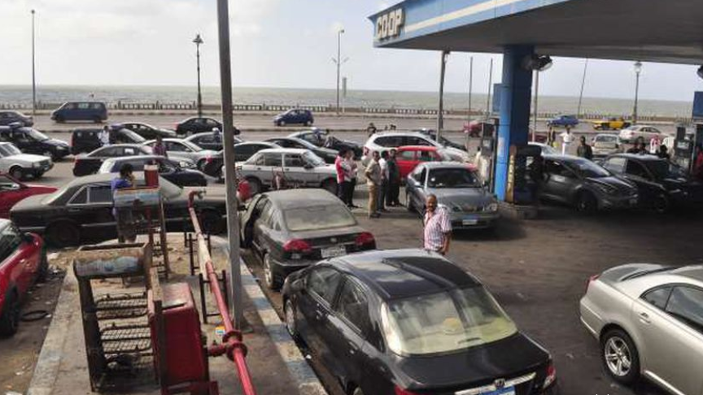
Instead of this being the problem that we see daily:

Slide 5
To solve this problem:
We can design the gas station in a better way, by making a main corridor for cars to enter the station, and then the corridor is divided into several roads, Each road has a gas dispenser with all kinds of gasoline, When finished, a car can leave from a road designated for it and not return from the road coming from it, to prevent cars from congesting and causing problems.

Slide 6
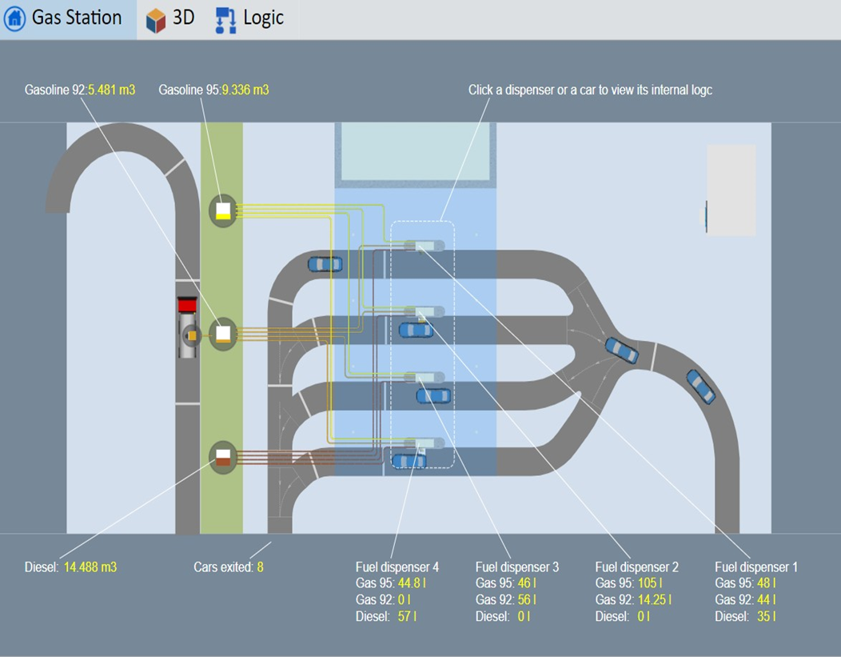
Structure of the gas station from above:

Slide 7
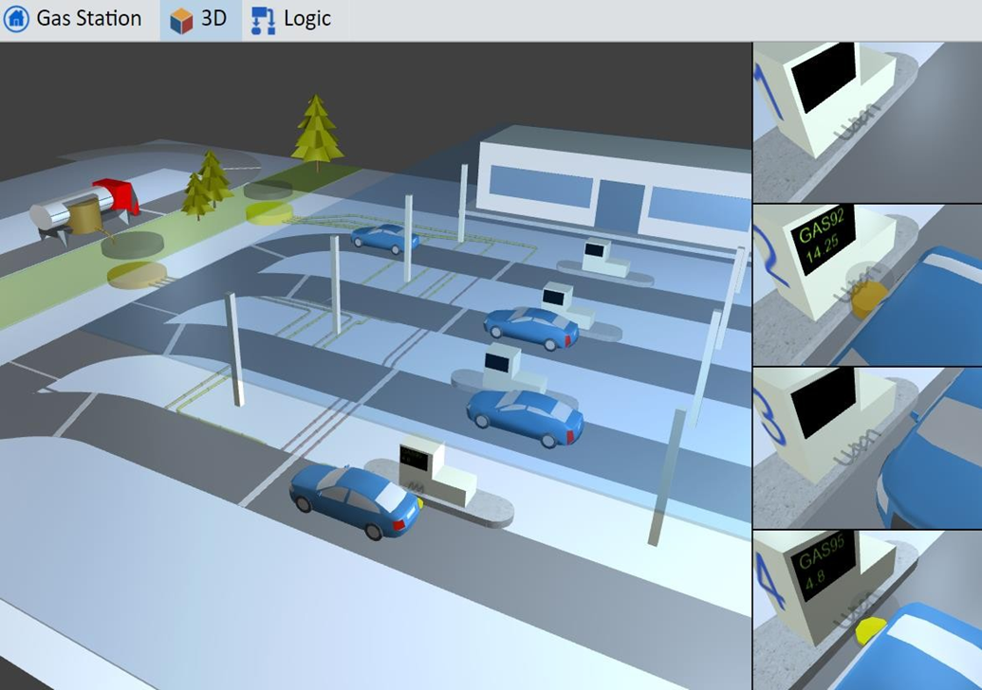
3 D drawing of the gas station:

Slide 8
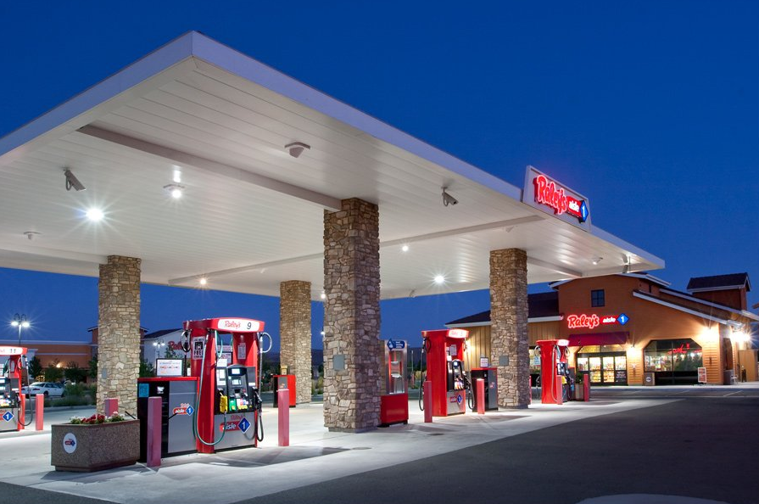
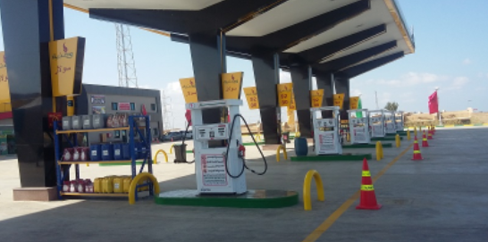
Gas stations will be designed like this:

Slide 9
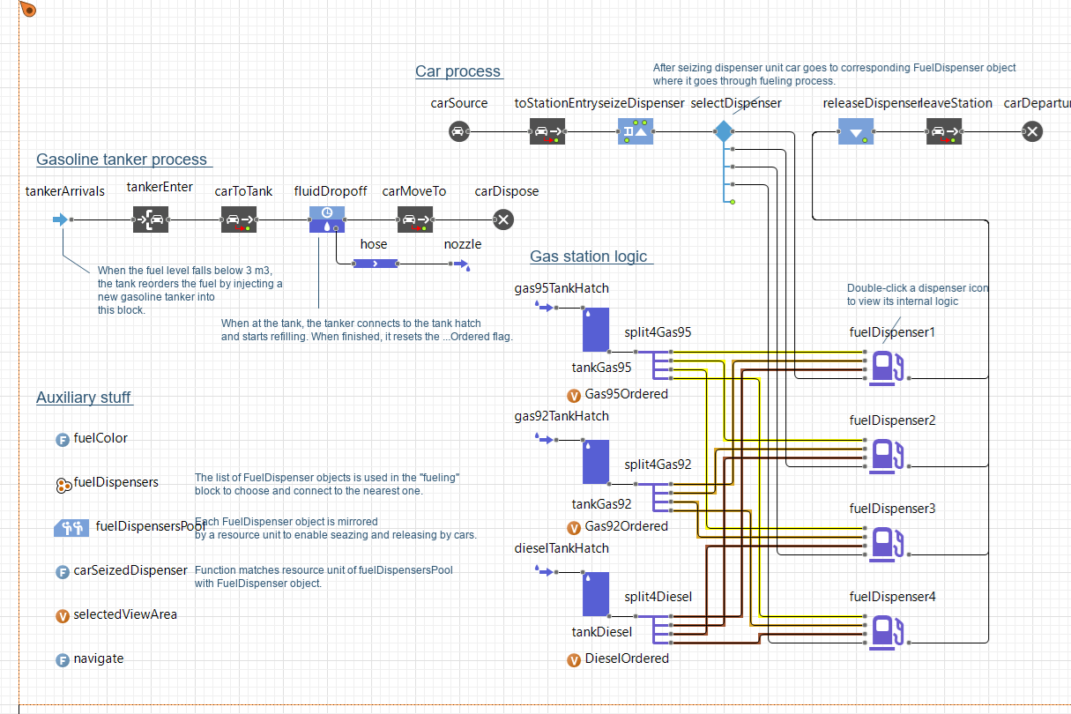
Cas station logic

Slide 10
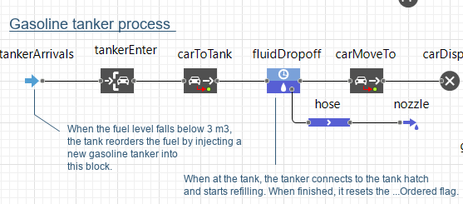
Casoline tanker process

Slide 11

Thanks

